Slide 1
BEING A GIRL IN MY SCHOOL
USKUDAR BIREY ANATOLIAN HIGH SCHOOL

Slide 2

Being a Girl in My School
As a girl in school, I've experienced first-hand the challenges and stereotypes that come with that identity. By sharing my story, I hope to inspire change and empower other girls to overcome these obstacles.

Slide 3



Stereotypes and Gender Discrimination
Expectations
Mansplaining
Toxic masculinity
Girls are expected to be quiet and studious, while boys are encouraged to be outgoing and assertive.
Even when girls speak up, they are often dismissed or talked over by their male peers.
Boys are often pressured to conform to societal expectations of what it means to be a "real man", leading to bullying and judgement towards those who don't fit the mold.

Slide 4
The Root of the Problem
Socialization
Lack of Role Models
Unconscious Bias
From a young age, girls are taught to be polite, nurturing, and submissive, while boys are taught to be independent and competitive.
There are few visible female leaders or strong female characters in media, leading to a lack of examples for girls to follow.
Teachers and parents often hold unconscious biases against girls, leading to harsher punishments and fewer opportunities for them.

Slide 5
Different Backgrounds, Different Experiences
Culture & Religion
Girls from different cultural or religious backgrounds may face unique challenges, such as pressure to conform or restrictions on clothing and behavior.
1
2
3
Economic Status
Sexual Orientation
Girls from lower income families often face additional challenges, such as lack of access to resources or pressure to support the family financially.
Girls who identify as LGBTQ+ may experience additional discrimination and marginalization, both from their peers and from society as a whole.

Slide 6

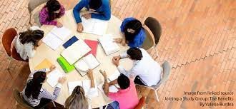
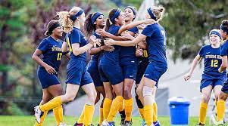
Supporting Girls in School
Mentorship
Empowerment Groups
Equal Opportunities
Girls benefit greatly from having strong female mentors to look up to, who can provide guidance and support.
Creating girl-centered spaces where they can connect with and support each other can be incredibly empowering.
Providing equal opportunities for girls to participate in sports, clubs, and other extracurricular activities can help to break down gender stereotypes and empower girls to pursue their passions.

Slide 7

Conclusion
By recognizing and addressing the challenges that girls face in school, we can create a more inclusive and empowering learning environment for everyone. Let's work towards a future where girls are supported, respected, and valued.
  Beril BALDEMIR
  Ilkyaz ONGEN
  Nehir TEKIN
  Halil Efe DEMIRTAS
  Engin Doruk ONGEN
  Mumin Arda SAKIR
ERASMUS+

